Slide 1
CO2402 - Advanced Programming with C++
Week 16 - Linked Lists
Gareth Bellaby

Slide 2
Topics
Pushing and popping the front of the list.
Back of the list.
Creating an ordered list using store.

Slide 3
Topic 1
Pushing and popping the front of the list

Slide 4
Introduction
Singly linked list.
Other variants exist, e.g. doubly-linked list, queue, de-queue.
Return to the topic at a later point.
I will use the same approach as container classes in the STL.
The syntax will be similar, e.g. my pushBack is the equivalent of push_back in the STL.

Slide 5
Example
I presented this example last week.
Consider a system to record student marks.
Each student has a list of modules studied. Each module has an associated mark and a code.
A fixed array is inefficient - a student can take between 1 - 7 modules depending on the circumstances. The data for the modules is stored using dynamic memory. The memory is allocated as modules are registered.
Need to use a flexible data structure that can add new data dynamically, i.e. whilst the programming is running. A linked list is an example of this.

Slide 6
Why create your own linked list
It is important to be able to build the data structures yourself.
Need to understand the data structures and this can only really be done if you implement them.
STL is not always appropriate so you do need to know how build a linked list.
Some important data structures are extensions of a linked list, e.g. trees.
Very good practice.

Slide 7
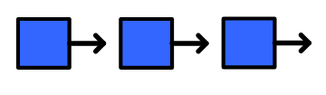
Linked List
An object is held within block of memory.
It is possible for an instance of a class to include a pointer to another instance of the same class.
The C++ compiler understands this type of syntax. It understands that a pointer is being declared in the context of a class definition.

Slide 8
The Element class
class Element
{
private:
Element* next;
int data;
public:
int getData( );
void setNext( Element* );
Element* getNext( );
Element::Element( int );
};

Slide 9
Methods of the Element class
// Constructor. An Element cannot be created
// unless it has data.
Element::Element( int d )
{
data = d;
}
// Get the data item from an element.
int Element::getData( )
{
return data;
}

Slide 10
Methods of the Element class
// Set the 'next' pointer of an Element
void Element::setNext( Element* tmp )
{
next = tmp;
}
// Get the 'next' pointer of an Element.
Element* Element::getNext( )
{
return next;
}

Slide 11
Linked List
A singly-Linked List has a Last-In, First-Out structure (LIFO).
The vector class is the STL implementation of a singly-linked list.
Using two classes: Element and LinkedList.
The Element comprises the individual links of the list.
The LinkedList class is a manager class. Looks after the linked list.
The Element class stores the data, whilst the LinkedList class manages the Element class.

Slide 12
Linked List
A sequence of links connected by a pointers.
An analogy is a train - the elements are the carriages of the train.
Works something like a stack.
New elements are pushed on to the front of the list.
When an element is pushed on to the list it becomes the new front of the list. It takes the place of the previous head.
The head points at the front of the list.

Slide 13
0 (zero)
The number 0 (zero) is treated as a memory location. A pointer can "point at" zero. Zero is never a real memory address.
The end of the list is signified by zero.
The 'next' pointer of the last link on the list points at zero.
In an empty list the 'head' pointer points at zero

Slide 14
Push front
You can see how the linked list is implemented by performing a sequence of pushes.
When the linked list is created 'head' points at zero.
The push operation is:
  Create a new element and assign data to it.
  Set the 'next' pointer of the new element to point at whatever 'head' is pointing at.
  Set 'head' to point at the new Element.

Slide 15
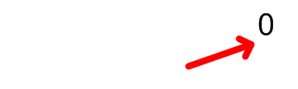
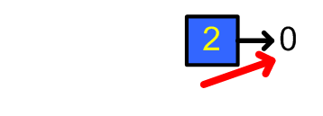
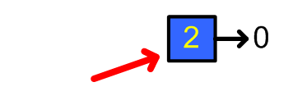
Push front - first element
Start. 'head' points at 0.
Create a new element.
Set the 'next' pointer of the new element to point at 'head' .
Set 'head' to point at the new Element.

Slide 16
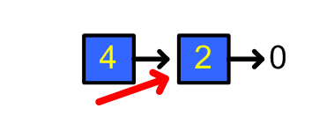
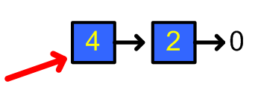
Push front diagram
'head' points at the front of the list.
Create a new element.
Set the 'next' pointer of the new element to point at 'head' .
Set 'head' to point at the new Element.

Slide 17
Pop Front
Record the data in the front element before doing the pop.
The pop operation is:
  If the list is not empty (test is 'head' does not point at zero)
  Use a temporary pointer to point at what 'head' is pointing at, i.e. point at the front element.
  Set 'head' to point at the whatever the 'next' pointer of the front element is pointing at.
  Delete the element that the temporary pointer is pointing at.

Slide 18
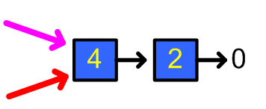
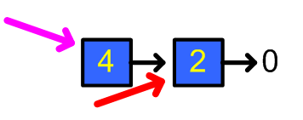
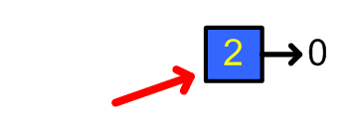
Pop front diagram
'head' is pointing at the front of the list.
Temporary pointer points at 'head'.
Set 'head' to point at the 'next' pointer of the front element.
Delete the element that the temporary pointer is pointing at.

Slide 19
The LinkedList class
class LinkedList
{
private:
Element* head;
public:
LinkedList::LinkedList( );
LinkedList::~LinkedList( );
void pushFront( int );
void popFront( );
int getFront( );
void display( );
};

Slide 20
Constructor
// Constructor. Set the head pointer to 0
LinkedList::LinkedList()
{
head = 0;
}

Slide 21
Destructor
// Destructor. Clean up the linked list.
LinkedList::~LinkedList()
{
Element* prior; // stores previous
while( head ) // 0 at the end of the list.
{
prior = head; // store previous
head = head->getNext( ); //advance head
delete prior; // destroy previous
}
}

Slide 22
pushFront
// Push the given data on to the front of the
// linked list. 'head' is updated.
void LinkedList::pushFront( int d )
{
// allocate memory for new element
Element* tmp = new Element( d ) ;
tmp->setNext( head ); // tmp in front of
// the old head of the list
head = tmp; // head updated
}

Slide 23
popFront
// Pop the front of the linked list. Deletes the
// first element (if one exists). 'head' is
// updated to point at the new front.
void LinkedList::popFront()
{
Element* tmp = head; // store old head
if ( head ) // if list has at least one element
{
head = head->getNext( );
delete tmp;
}
}

Slide 24
getFront
// Returns the first element on the linked list.
// If empty then exit with an error message.
int LinkedList::getFront( )
{
if( head ) // check list has at least one link
{
return head->getData( );
}
// only reached if the linked list is empty
cout << "ERROR: list is empty" << endl;
system( "pause" );
exit( 0 );
}

Slide 25
display
// Display each of the items on the linked list
void LinkedList::display()
{
Element* search = head; // can't use
// 'head' else we'd loose track of the list start
while( search ) // 0 at the end of the list.
{
cout << search->getData( ) << endl;
search = search->getNext( );
}
cout << endl;
}

Slide 26
Discussion
Constructor sets up the linked list. The list is empty to begin with so 'head' is points at 0.
Destructor acts as a "clean up" function. It goes through each element left on the list and deallocates their memory.
The display function moves through each element of the list outputting the data held by each. Note that it cannot use the 'head' pointer to go through the list. The 'head' pointer points at the head of the list - if it moved we would no longer know where the start of the list is.
Push follows the given algorithm.

Slide 27
Discussion
Pop follows the given algorithm.
Pop deletes the front of the linked list. Need to write the getFront() function in order to obtain the data held by the front element.
Need to store the front of the list before doing moving 'head' so that we can subsequently delete the previous front of the list.
The pop function cannot just delete the front of the list. Head has to be advanced first otherwise you would no longer know where the start of the list is.

Slide 28
Topic 2
Back of the list

Slide 29
Back
Push and pop were both performed at the front of the list. The front of the list is straightforward.
Pushing and popping from the back of the list is not needed. The linked list works without them. However, it would be more flexible to be able to push and pop at the back as well.
Can modify singly-Linked List so that you can push and pop from either end.

Slide 30
Push back
The pushBack operation is:
  Create a new element and assign data to it.
  Set the 'next' pointer of the new element to zero since it is going to be the last element of the list.
  If the list is empty then
    Set 'head' to point at the new Element.
  If the list is not empty then
    Find the last element of the list. Note that you need to examine the 'next' pointer before moving on.
    Set the 'next' pointer of the last element to point at the new element.

Slide 31
pushBack code
void LinkedList::pushBack( int d )
{
Element* tmp = new Element( d ) ;
tmp->setNext( 0 );
if( head ) // the list is not empty
{
Element* current = head;
while ( current->getNext() )
{
current = current->getNext( );
}
current->setNext( tmp );
}
else // list is empty {
head = tmp; // head points at new item
}
}

Slide 32
Pop back
Record the data in the last element before doing the pop.
Need to find the last element, but also need to remember the previous element as you go through the list because the previous element will have to point at zero after the pop operation.

Slide 33
Pop back
The popBack operation is:
  If the list is not empty.
    Find the last and the next-to-last elements of the list. Use two pointers to do this. The 'current' pointer is used to go through the list until its 'next' points at zero. Before the 'current' pointer moves on, set a 'nextToLast' pointer to point at 'current'.
    Set the 'next' pointer of 'nextToLast' to zero.
    Delete 'current' (i.e. the last element).

Slide 34
popBack code
void LinkedList::popBack( )
{
if ( head ) { // check at least one element
if( head->getNext() == 0 ) { // only one
delete head; // delete it
head = 0; // list is now emtpy
}
else {
Element* nextToLast;
Element* current = head;
while ( current->getNext() ) {
nextToLast = current;
current = current->getNext( );
}
nextToLast->setNext( 0 ); delete current;
}
}
}

Slide 35
Get back
Need to obtain data held by the last element of the list before it can be popped.
This is the same as using get front when popping from the front of the list.
If the list is not empty then simply find the last element of the list.

Slide 36
getBack
int LinkedList::getBack( )
{
if( head ) // check at least one element
{
Element* current = head;
while ( current->getNext() )
{
current = current->getNext( );
}
return current->getData( );
}
// only reached if the linked list is empty
cout << "ERROR: list is empty" << endl;
system( "pause" );
exit( 0 );
}

Slide 37
Topic 3
Creating an ordered list using store

Slide 38
Sorting
Employ a driver loop to go through the linked list.
If we want to store the data in an ascending order then the loop keeps until the data on current element is greater than the new data to be stored.

Slide 39
Sorting
There are 4 cases. The first 3 are operations you have already met.
The data goes on the front of the list. The operation is the same as push front.
The goes on the back of the list. The operation is the same as push back.
The linked list was empty and the new data is the first ever element on the list.

Slide 40
Sorting
The new data goes in the middle of the linked list. We need to break the chain and place the new element within the break. Need to remember the element prior to current so that the chain can be remade. The next pointer of prior will point at the new element, whilst the next pointer of the new element will point at current.

Slide 41
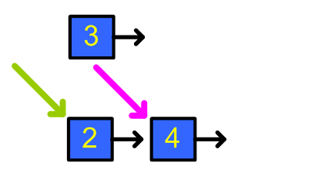
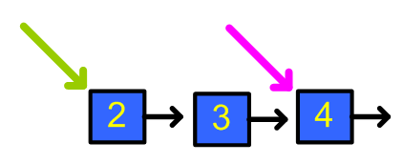
Sorting
Insert 3 into a list containing 2, 4.
Go through list until current is greater than the new element.
Remember the element prior to current.
Set the next pointer of prior to point at the new element.
Set the next pointer of the new element to point at current.

Slide 42
pushSort
void LinkedList::pushSort( int d )
{
// allocate memory for new element
Element* tmp = new Element( d ) ;
Element* current = head;
Element* prior = 0;

Slide 43
pushSort
while( current ) {
if( current->getData() <= d ) { // carry on
prior = current;
current = current->getNext( );
}
else {
if( prior ) { // goes in the middle
prior->setNext( tmp );
tmp->setNext( current );
return; // stop
}
tmp->setNext( current ); // new front
head = tmp;
return; // stop
}
}

Slide 44
pushSort
if( prior ) // put on end
{
prior->setNext( tmp );
tmp->setNext( 0 );
return; // stop
}
else // first ever element in list
{
tmp->setNext( current );
head = tmp;
}
}

